Slide 1

TUTORIAL FOR THE COLLABORATIVE ENVIRONMENT
- Adiministrator version -

Slide 2
INDEX
BASELINE FUNCTIONALITIES:
FUNCTIONALITIES FOR ADMINISTRATORS OF A CO-PRODUCTION PROCESS
See BASIC-TUTORIAL-PARTICIPANTS
How to create a co-production process
How to customize your process
How to create an organization
How to create a team
How to clean or delete a co-production process
Portal public pages
Login and registration
Personal workspace
How a co-production process looks like
How to edit resources
How to create a new resource
How to share the link to a resource

Slide 3
How to create a new co-production process

Slide 4
Start from a published Story

Slide 5
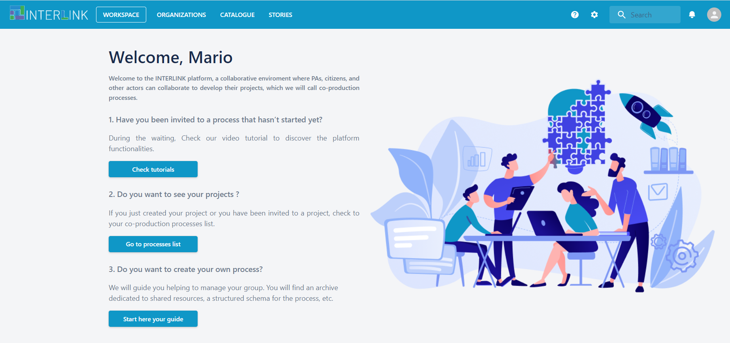
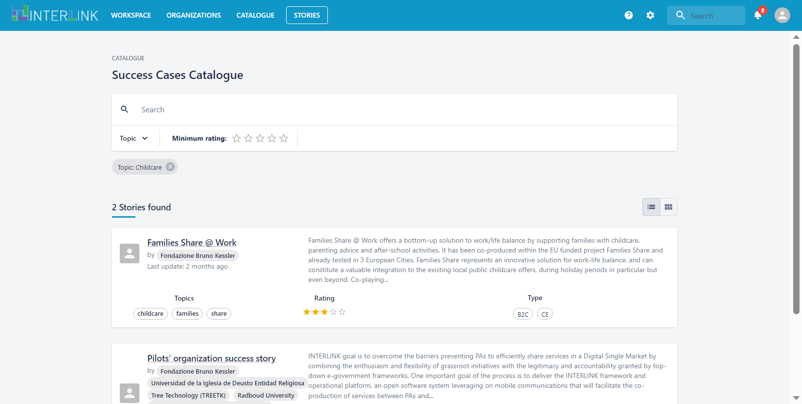
Take inspiration from published Stories
Access the Collaborative Environment. From your personal workspace, click on the tab named «Stories» at the very top. This will show you a list of published co-production Stories that have been experienced by other Public Administrations. Inspect the details of the Stories by clicking on their names.

Slide 6
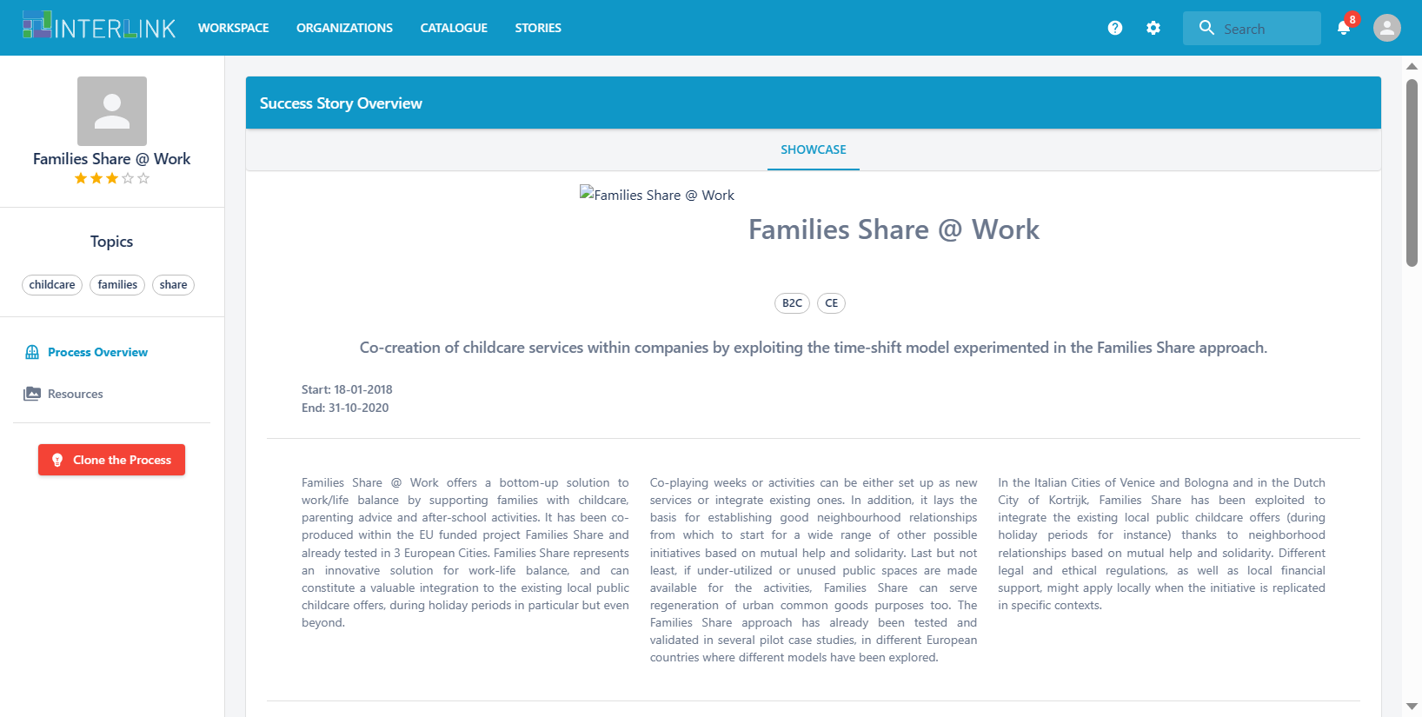
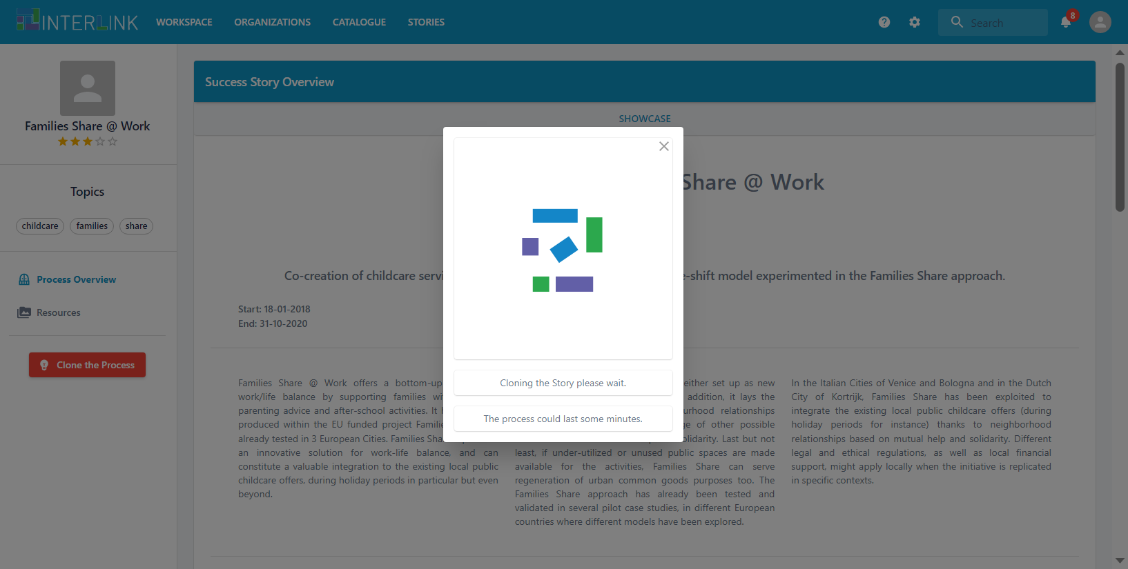
Clone a Story
By clicking on the red button named «Clone the process», a copy of the co-production process will be created for you.
Check out the list of co-production processes listed in your workspace: there will be a newly created process named «Copy of …..» at the end. This process contains copies of the original resources that can be safely edited.

Slide 7
Clone a co-production process of yours

Slide 8
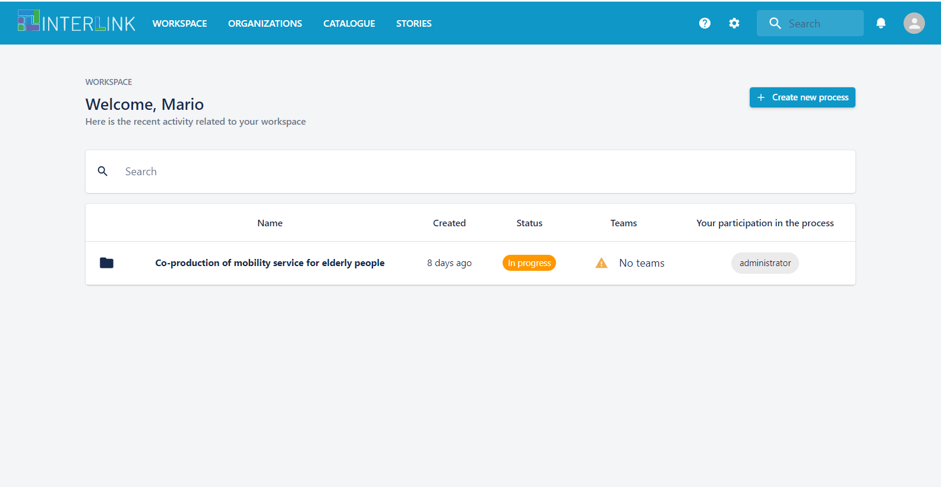
Start from a previous process
Connect to your personal Workspace and open the list of your co-production processes.
You can open a co-production process that you created in the past (one for which you are Administrator).

Slide 9
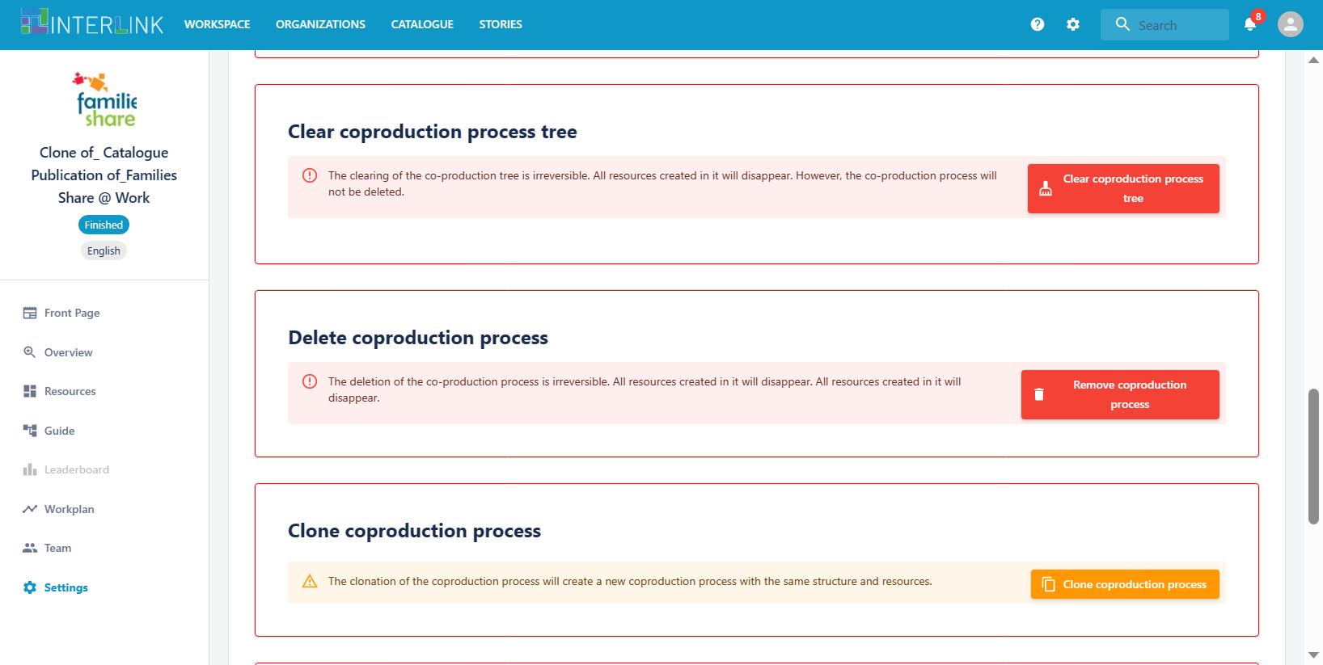
Create a reusable copy of your process
Go the the «Settings» section.
Scroll down to find the Clone coproduction process option. Click the orange button and a reusable copy of your process will be created. (Resources will be copies of original documents, so that you can safely edit them)

Slide 10
Create a new process from an available co-production schema

Slide 11
Start the guided procedure
Connect to your personal Workspace and open the list of your co-production processes.
Click on the blue button «Create new process».
A pop up will appear, where you can insert a title and a description for your new co-production process (you will be able to change the text later on in the process settings).

Slide 12
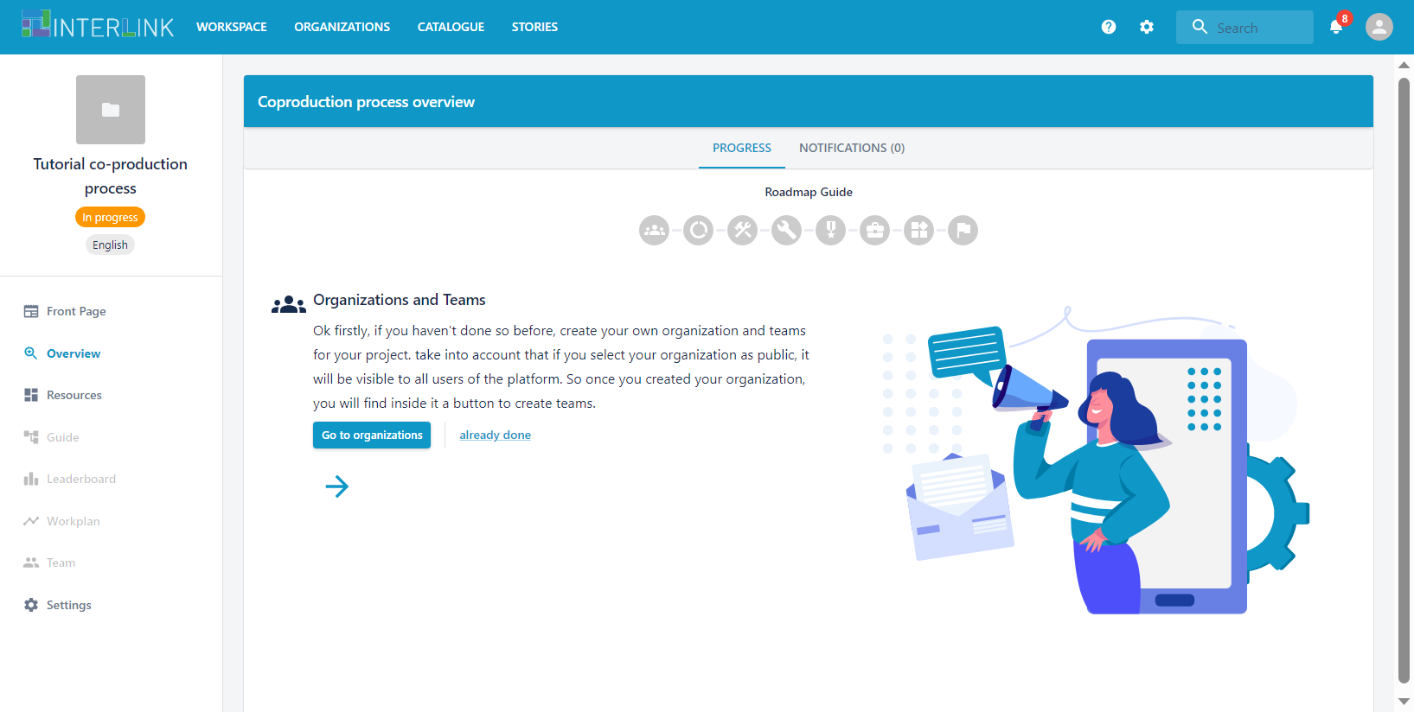
Follow the suggested steps for process creation
When the co-production process is created, you will be redirected to a space that collectes all its information and resources. The «Overview» section will be opened by default. It presents a guided procedure of seven steps to help you set up the process.

Slide 13
STEP 1. Create organizations and teams
Each co-production process needs to be assigned 1 or more teams of participants.
If it is the first time you create a co-production process, you may need to create teams of people and respective organizations first. The blue button «Go to organizations» will take you to the corrisponding section.
The link «already done» marks this task as already completed.

Slide 14
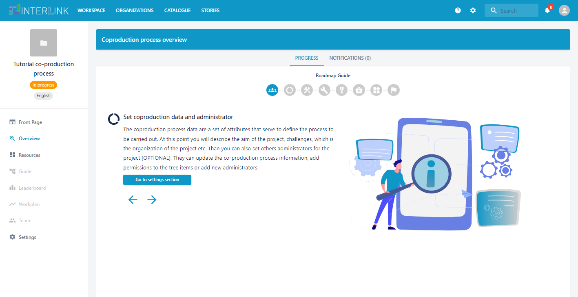
STEP 2. Describe the process and set administrator
In the second step, you are suggested to go to the «Settings» section of the process to fill in further details describing your process. From there you can also define who are the Administrators of the process

Slide 15
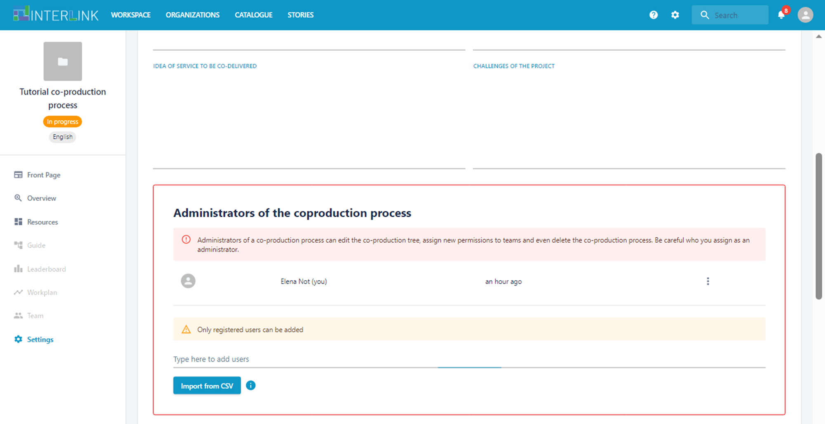
STEP 2.1
Choose administrators
You can modify the list of adminsitrators of your co-production process at any time from the «Settings» section.
New administrators can be added by typing their email addresses or by importing a file in CSV format with a list of email addresses to be added.
(Only email addresses of people already registered to the platform will be recognized by the system)

Slide 16
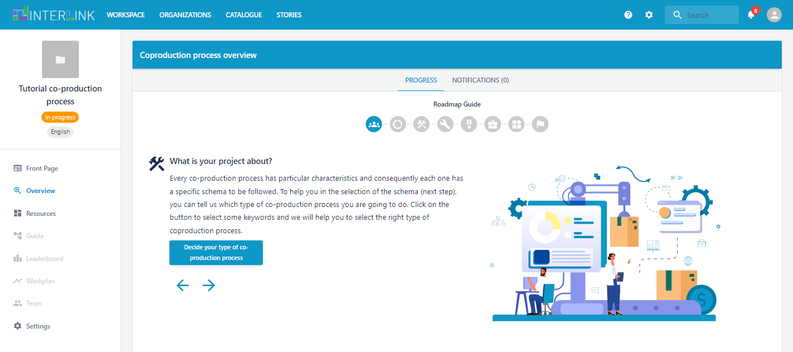
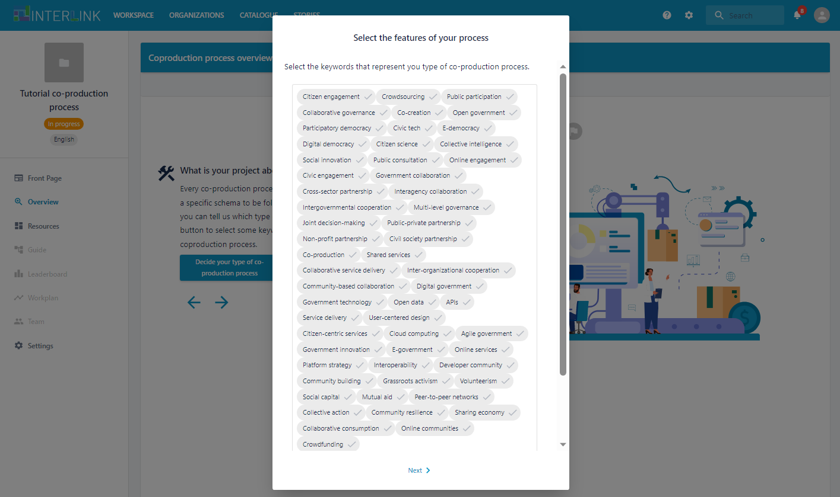
STEP 3. Choose semantic tags for your process
In the third step, you are suggested to select some keywords that characterize your co-production process.
This keywords will be transformed into semantic tags used to facilitate search and filtering of processes

Slide 17
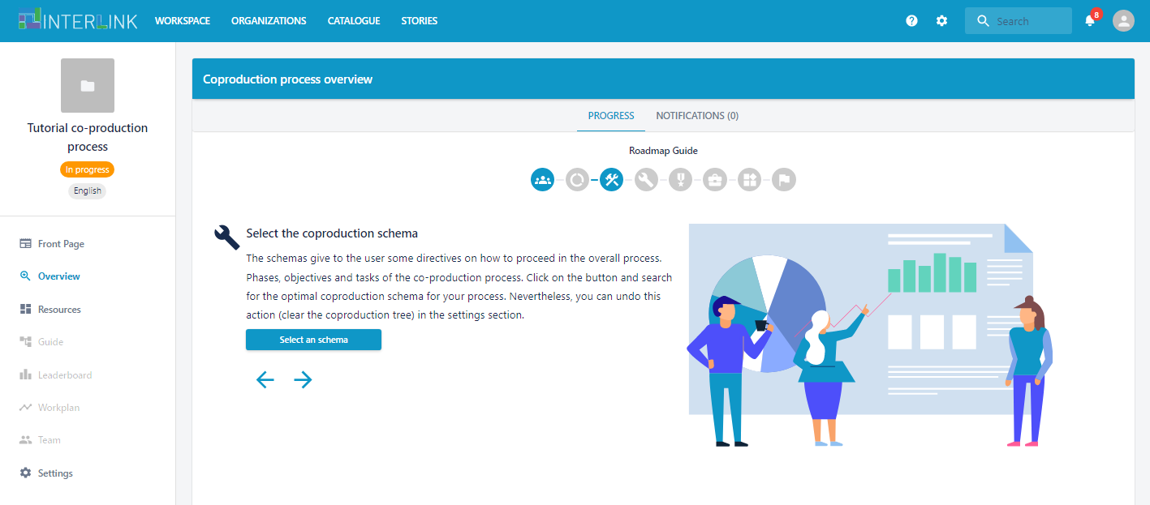
STEP 4. Select the co-production schema
In the fourth step, you are prompted to choose a co-production schema, i.e. a backbone list of phases and tasks to structure your co-production process starting from suggested templates.
Proceed with clicking the «Select a schema» blue button.

Slide 18
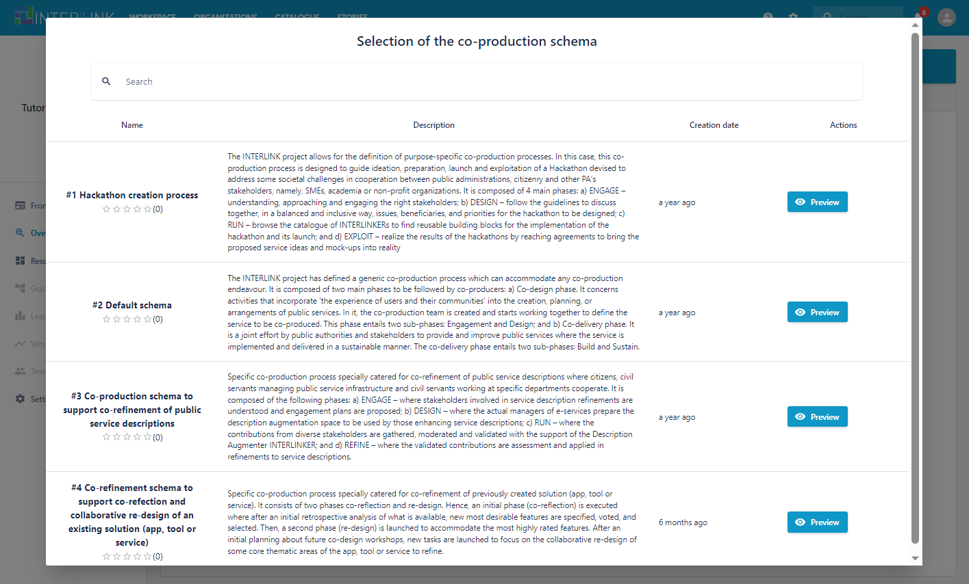
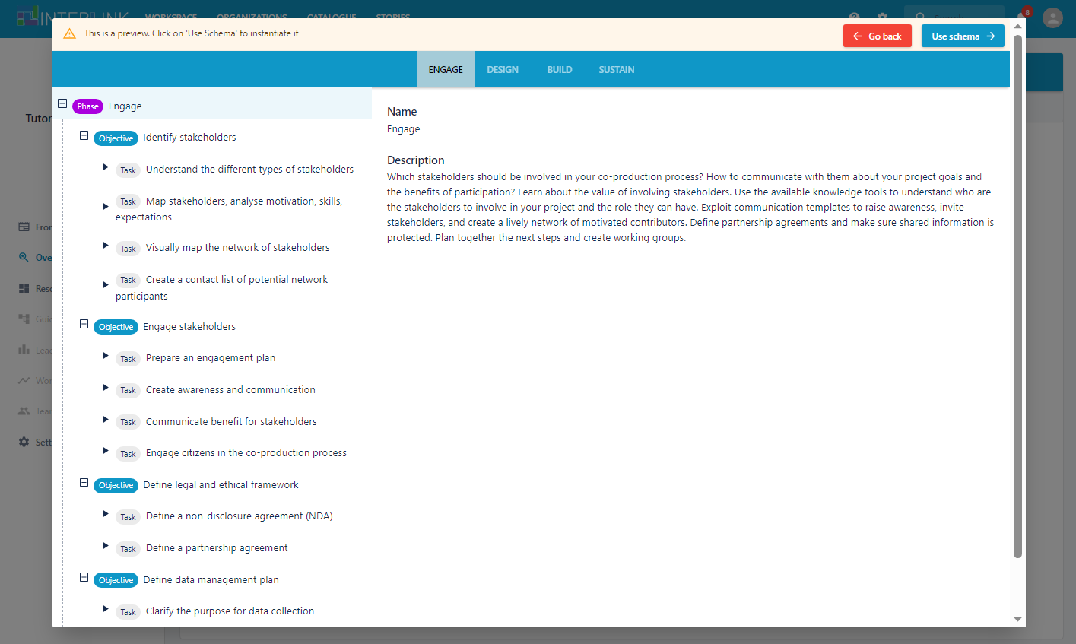
STEP 4.1
Preview and select the schema
You will be presented with a list of schemas that offer sample lists of co-production steps.
You can preview each of them by pressing the «Preview» button.
When you find the schema that matches at least partly your needs you can press the blue button «Use schema».
KEEP IN MIND THAT YOU WILL BE ABLE TO CUSTOMIZE THE SCHEMA.

Slide 19
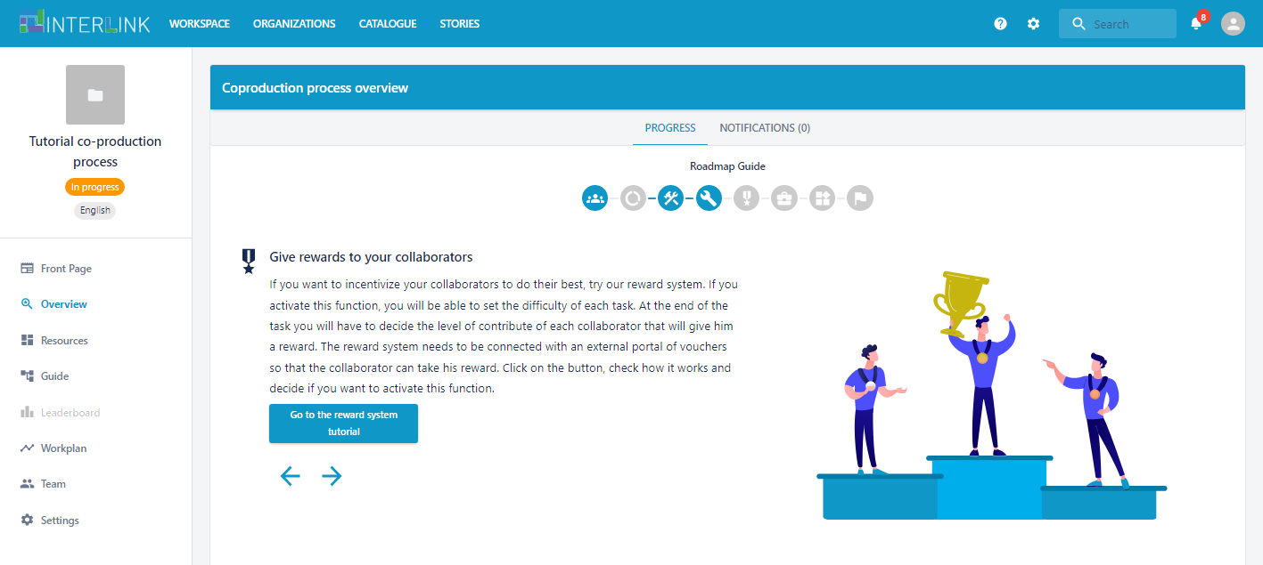
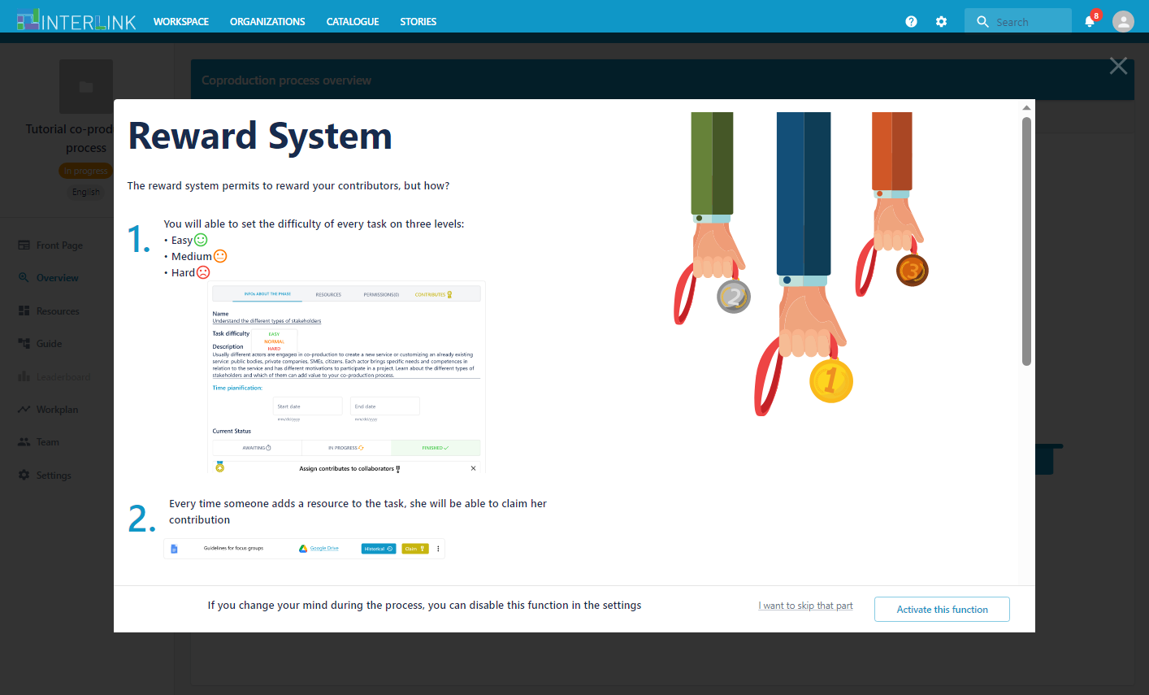
STEP 5. Activation of incentivization
In the fifth step, you are suggested to consider activating mechanisms for tracking participants’ contributions to compute points and quantify contributions (in conjunction with appropriate communications) to incentivise participation and potentially reward it.
An online tutorial is available to explain how the system works.

Slide 20
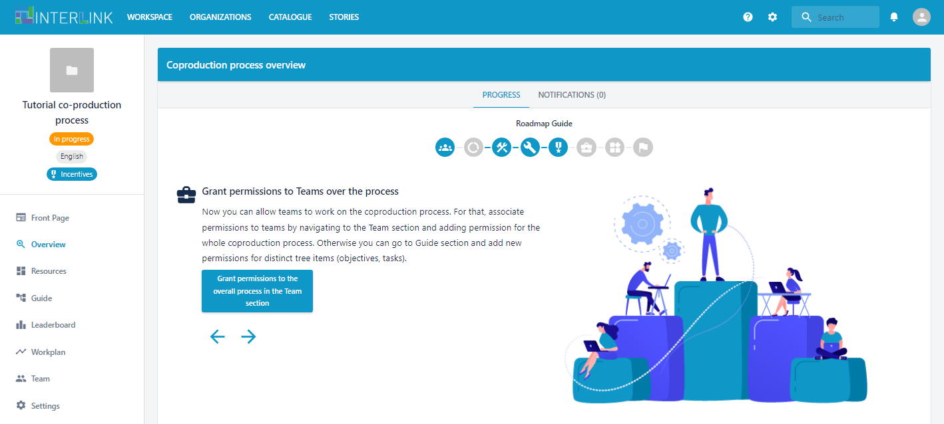
STEP 6. Grant access rights to teams
In the sixth step, you are suggested to assign access rights to the resources that will be created during the co-production process.
You will be asked to select the teams of people to be associated to the co-production process.
TIP: further teams can be added (or removed) at any time, from the «Team» section

Slide 21
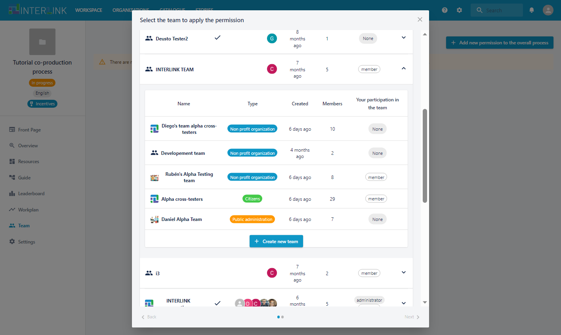
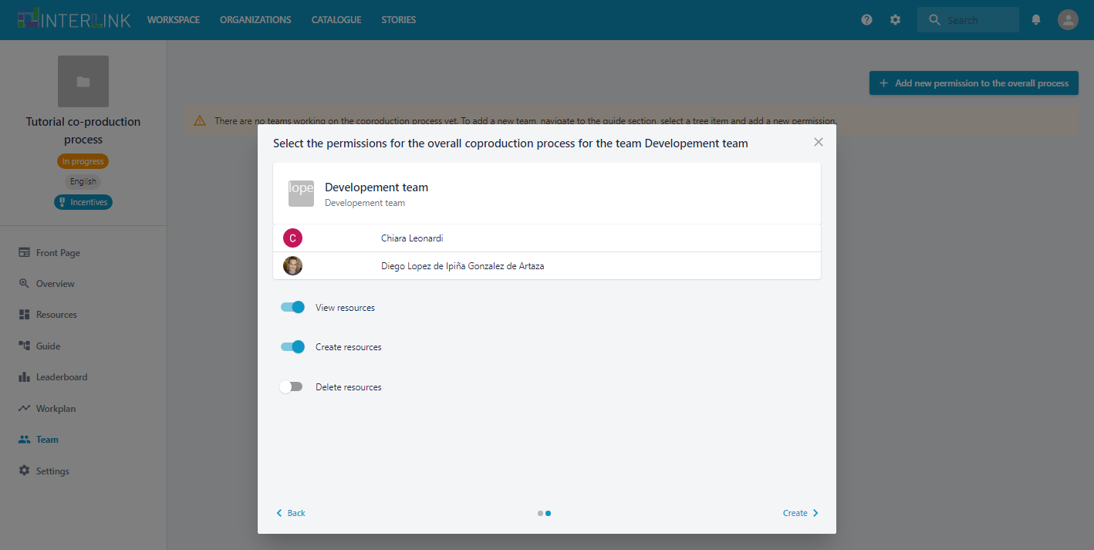
STEP 6.1 Select the teams
From the «Team» section, by pressing the blue button at the top right called «Add new permission to the overall process» you will be shown the list of public organizations and the relative teams. You can select the team(s) that you to involve in the co-production process and activate the appropriate access rights.
TIP: if you want to fine-tune the access rights of specific phases or tasks you will be able to do so from the «Permissions» tab of the specific phase/task

Slide 22
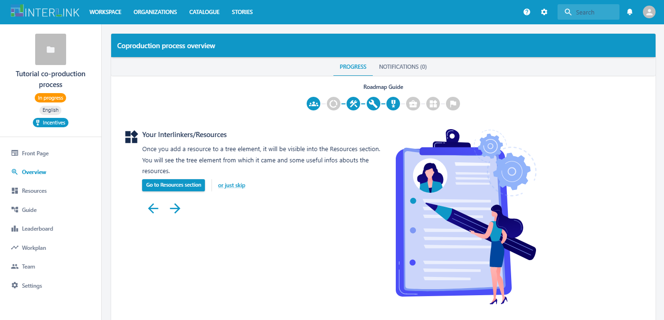
STEP 7. Learn about the repository of Resources
The last step in the guided procedure for creating a co-production process, simply explains to platform users that a specific «Resources» section is available that will collect all the shared resources created during co-production

Slide 23
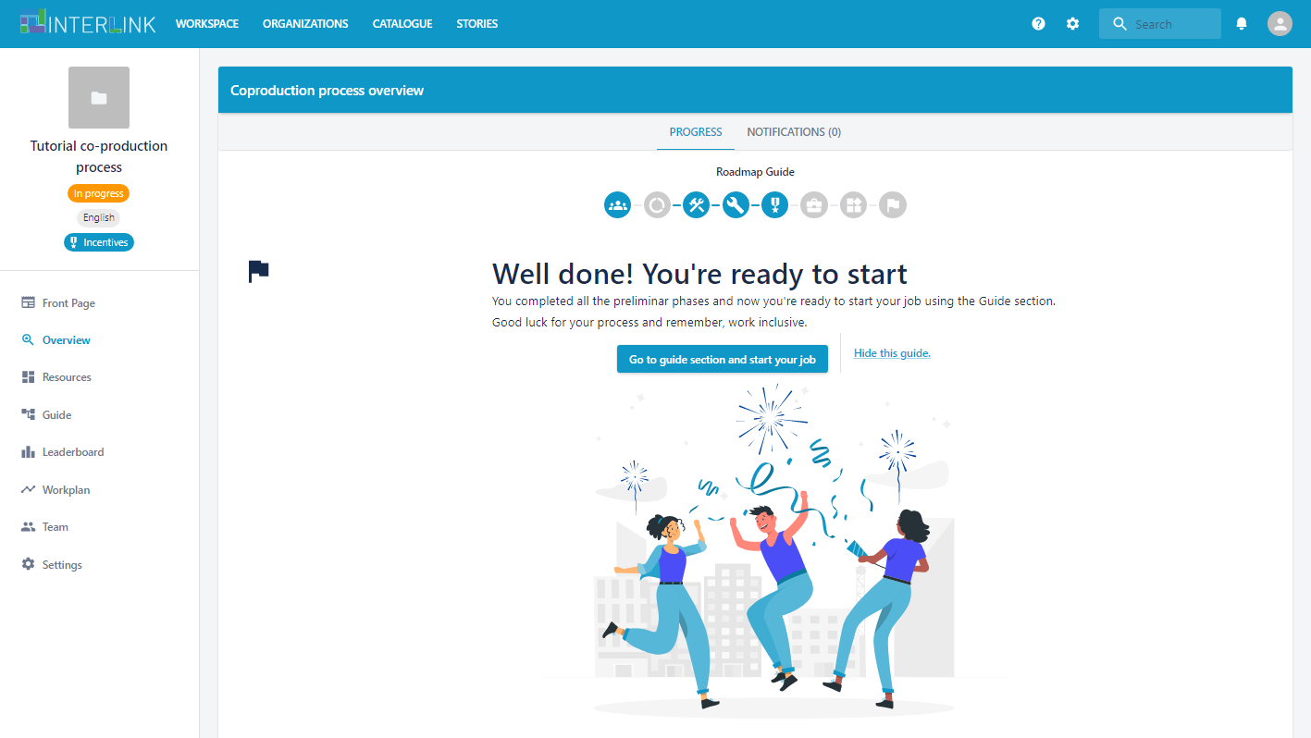
Co-production creation completed
The last step in the guided procedure for creating a co-production process, simply explains to platform users that a specific «Resources» section is available that will collect all the shared resources created during co-production

Slide 24
How to customize the structure of your co-production process

Slide 25
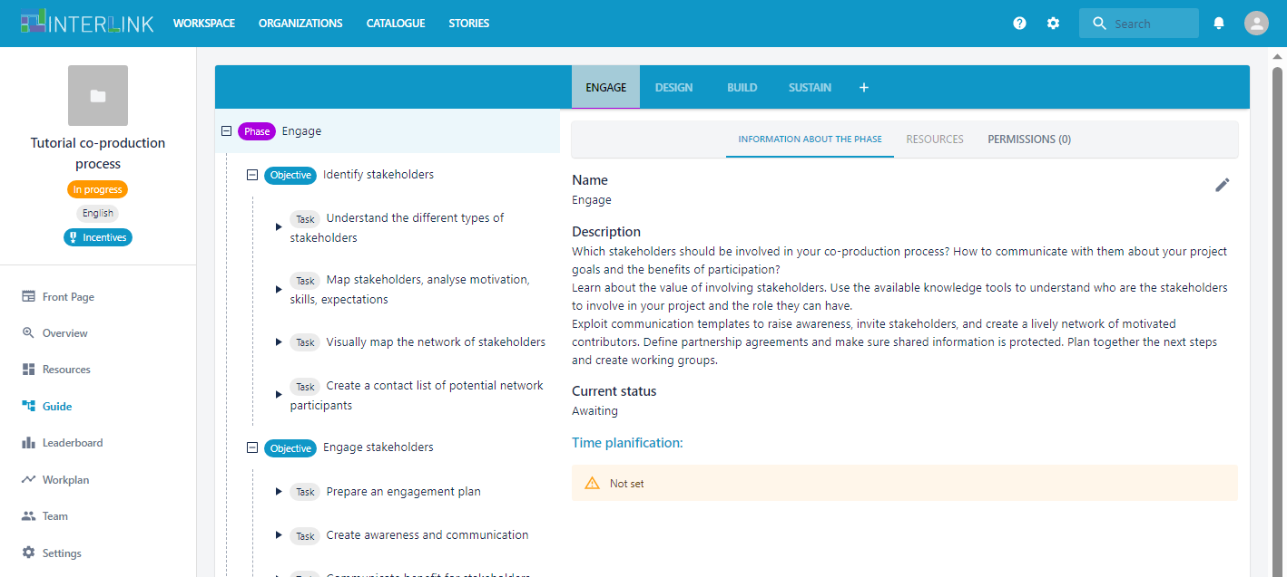
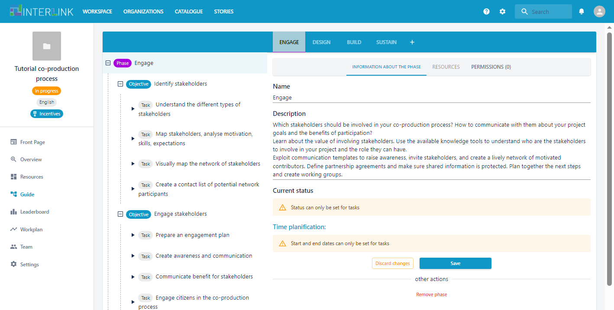
Edit or remove one item in the process structure
From the «Guide» section, just click the over the element in the tree (phase, objective, task) that you want to modify.
From the «Information about the phase/objective/task» tab click on the pencil icon.
You will be able to edit the textual information or remove the item from the tree. For task you can also select the current status and the time planning.

Slide 26
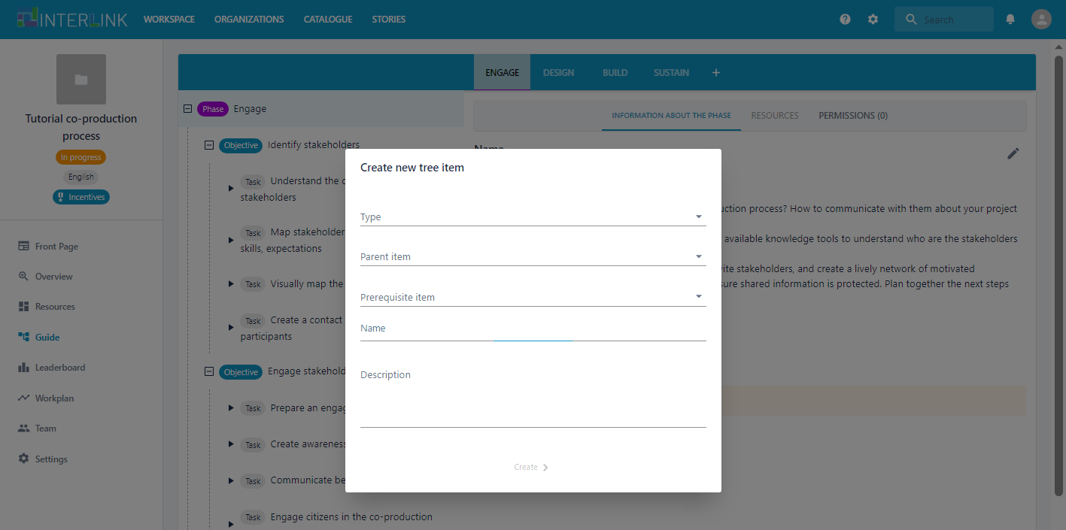
Add a new item in the process structure
From the «Guide» section, click on the «+» icon at the end of the tabs listing the names of the phases.
A pop up will show up that will allow you to select the type of item to add (new phase/objective/task) and its desired position in the tree (parent node and sister node that comes before, if any)

Slide 27
How to create an organization

Slide 28
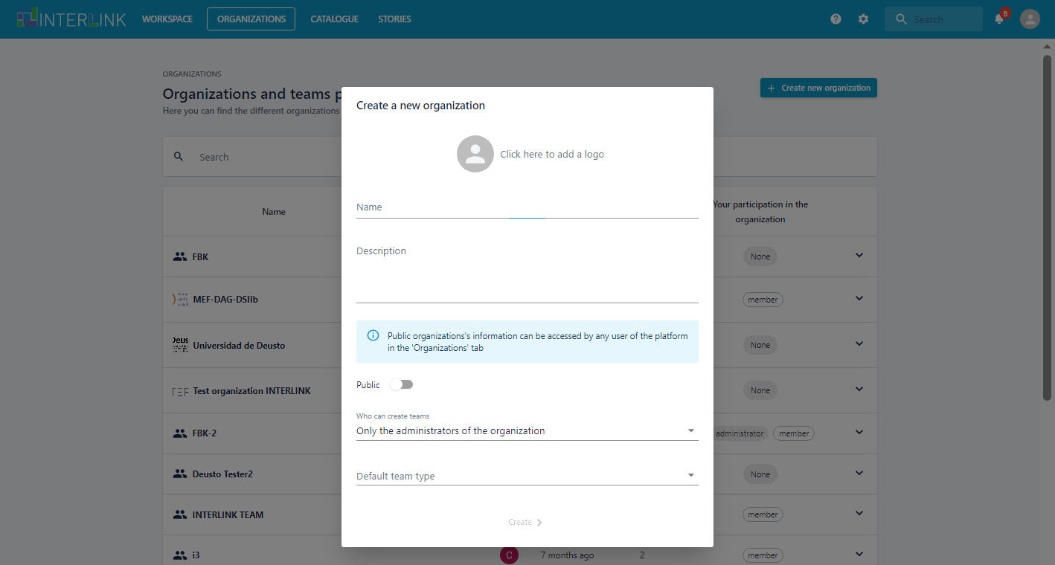
Create a new organization
From the top menu select the «Organizations» tab.
This section lists all the organizations that are visible for you.
Click on the «Create a new organization» blue button on the top left.
This will open a new pop up where you can edit the details for the new organization.

Slide 29
How to create a team

Slide 30
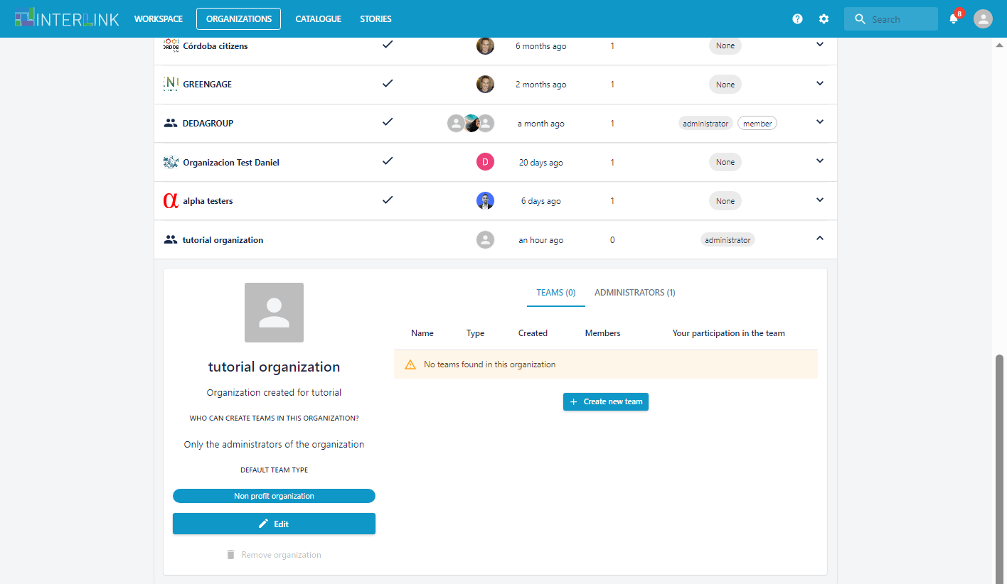
Create a new team
From the top menu select the «Organizations» tab.
Select an organization that will host the team you want to create.
Then click on the blue button «Create new team».

Slide 31
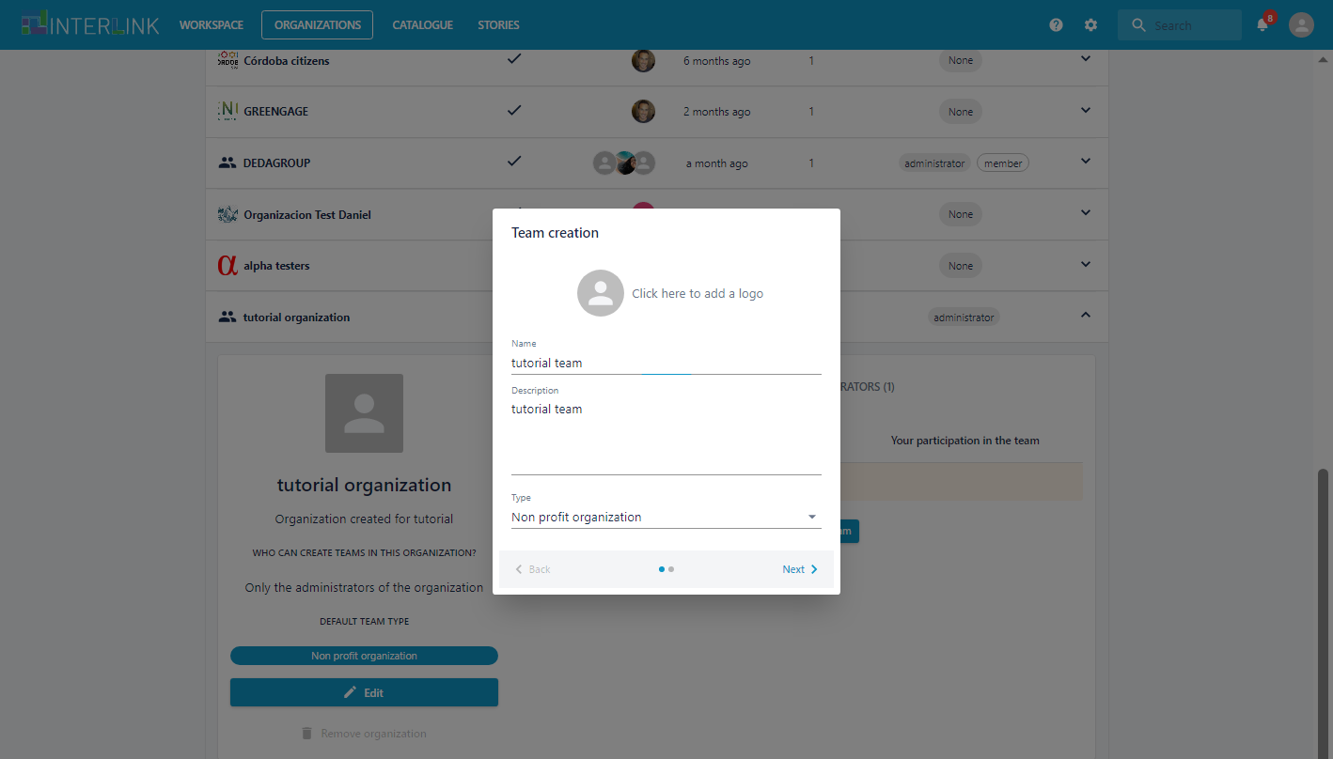
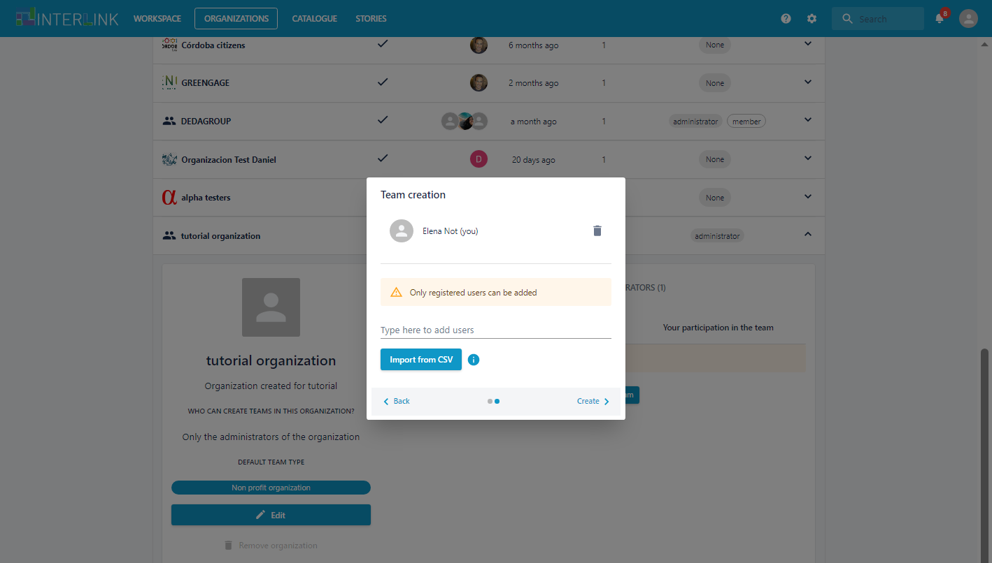
Edit the team details and add people
Insert a name and a description for the team.
In the following step insert the email addresses of new members for the team.
You can also import them from a CSV file.
(Only email addresses of people already registered to the platform will be recognized by the system)

Slide 32
How to clean or delete a co-production process

Slide 33
Remove contents or the whole process
Open the co-production process you want to modify. Go the «Settings» section.
Scroll down to find the type of action that you want to perform.
Press the red button in the «Clear» section if you want to remove all the resources of that process as well as its schema (all the phases and tasks).
Press the red button in the «Delete» section, if you want to remove the process completely.

Slide 34
You are now ready to coordinate the co-production of services !
FOR MORE INFORMATION, CHECK OUT
THE USER MANUAL OF THE INTERLINK PLATFORM

Slide 35
This document, prepared by the INTERLINK European project, is licensed under a Creative Commons Attribution-ShareAlike 4.0 International licence (CC BY-SA 4.0).

